Slide 1
Engineering Economy
Chapter 7: Depreciation and Income Taxes

Slide 2
The objective of Chapter 7 is to explain how depreciation affects income taxes, and how income taxes affect economic decision making.

Slide 3
Income taxes usually represent a significant cash outflow. In this chapter we describe how after tax liabilities and after-tax cash flows result in the after-tax cash flow (ATCF) procedure. Depreciation is an important element in finding after-tax cash flows.

Slide 4
Depreciation is the decrease in value of physical properties with the passage of time.
It is an accounting concept, a non-cash cost, that establishes an annual deduction against before-tax income.
It is intended to approximate the yearly fraction of an asset’s value used in the production of income.

Slide 5
Property is depreciable if
it is used in business or held to produce income.
it has a determinable useful life, longer than one year.
it is something that wears out, decays, gets used up, becomes obsolete, or loses value from natural causes.
it is not inventory, stock in trade, or investment property.

Slide 6
Depreciable property is
tangible (can be seen or touched; personal or real) or intangible (such as copyrights, patents, or franchises).
depreciated, according to a depreciation schedule, when it is put in service (when it is ready and available for its specific use).

Slide 7

Straight line (SL): constant amount of depreciation each year over the depreciable life of the asset.
N = depreciable life
B = cost basis
d_{k} = depreciaton in k
BV_{k} = book value at end of k
SV_{N} = salvage value

Slide 8
Pause and solve
Acme purchased a coordinate measurement machine (CMM). The cost basis is $120,000 and it has a seven year depreciable life. Acme estimates a salvage value of $22,000 at the end of seven years. Determine the annual depreciation amounts using SL depreciation. Tabulate the annual depreciation amounts and book value of the CMM at the end of each year.

Slide 9
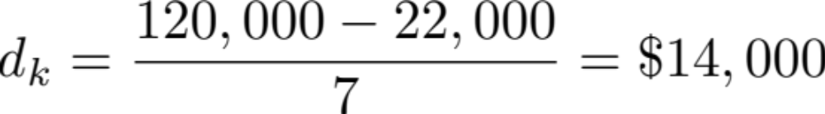
Solution
B = $120,000 SV = $22,000 N = 7 years
Year | Depreciation | Ending Book Value
1 | $14,000 | $106,000
2 | $14,000 | $92,000
3 | $14,000 | $78,000
4 | $14,000 | $64,000
5 | $14,000 | $50,000
6 | $14,000 | $36,000
7 | $14,000 | $22,000

Slide 10


Declining-balance (DB): a constant-percentage of the remaining BV is depreciated each year.
The constant percentage is determined by R, where R = 2/N when 200% declining balance is being used, R = 1.5/N when 150% declining balance is being used.

Slide 11

The units-of-production method can be used when the decrease in value of the assset is mostly a function of use, instead of time. The cost basis is allocated equally over the number of units produced over the asset’s life. The depreciation per unit of production is found from the formula below.

Slide 12
The Modified Accelerated Cost Recovery System (MACRS) is the principle method for computing depreciation for property in engineering projects. It consists of two systems, the main system called the General Depreciation System (GDS) and the Alternative Depreciation System (ADS).

Slide 13
When an asset is depreciated using MACRS, the following information is needed to calculate deductions.
Cost basis, B
Date the property was placed into service
The property class and recovery period
The MACRS depreciation method (GDS or ADS).
The time convention that applies (half year)

Slide 14
Using MACRS is easy!
Determine the asset’s recovery period (Table 7-2).
Use the appropriate column from Table 7-3 that matches the recovery period to find the recovery rate, r_{k}, and compute the depreciation for each year as

Slide 15
There are many different types of taxes.
Income taxes are assessed as a function of gross revenues minus allowable expenses.
Property taxes are assessed as a function of the value of property owned.
Sales taxes are assessed on the basis of purchase of goods or services.
Excise taxes are federal taxes assessed as a function of the sale of certain goods or services often considered nonnecessities.
We will focus on income taxes.

Slide 16

Taking taxes into account changes our expectations of returns on projects, so our MARR (after-tax) is lower.

Slide 17
The after-tax MARR should be at least the tax-adjusted weighted average cost of capital (WACC).
λ = fraction of a firm’s pool of capital borrowed from lenders
t = effective income tax rate as a decimal
i_{b} = before-tax interest paid on borrowed capital
e_{a} = after-tax cost of equity capital

Slide 18
Depreciation is not a cash flow, but it affects a corporation’s taxable income, and therefore the taxes a corporation pays.
Taxable income = gross income
– all expenses except capital invest.
– depreciation deductions.

Slide 19

Federal taxes are calculated using a set of income brackets. each applying a different tax rate on the marginal value of income. State taxes vary widely.
Tax rates are found in Table 7-5.
Corporations need to know their effective tax rate, which is a combination of federal and state taxes according to either formula below.

Slide 20
Pause and solve
Last year Acme, Inc. had $16.4 million in revenue, $1.2 million of operating expenses, and depreciation expenses of $5.4 million. Using the corporate federal tax rates from the table provided in the text, what is the approximate federal tax this corporation will have to pay for this tax year?

Slide 21

Solution
Last year Acme, Inc. had $16.4 million in revenue, $1.2 million of operating expenses, and depreciation expenses of $5.4 million. Using the corporate federal tax rates from the table provided in the text, what is the approximate federal tax this corporation will have to pay for this tax year?

Slide 22
The disposal of a depreciable asset can result in a gain or loss based on the sale price (market value) and the current book value
A gain is often referred to as depreciation recapture, and it is generally taxed as the same as ordinary income. A loss is a capital loss. An asset sold for more than it’s cost basis results in a capital gain.

Slide 23
Pause and solve
Acme Casting and Molding sold a piece of equipment during the current tax year for $67,000. This equipment had a cost basis of $210,000 and the accumulated depreciation was $153,000. Assume the effective income tax rate is 40%. Based on this information, what is
the gain (loss) on disposal,
the tax liability (or credit) resulting from this sale, and
the tax liability (or credit) if the accumulated depreciation was $125,000 instead of $153,000?

Slide 24

Solution
Acme Casting and Molding sold a piece of equipment during the current tax year for $67,000. This equipment had a cost basis of $210,000 and the accumulated depreciation was $153,000. Assume the effective income tax rate is 40%. Based on this information, what is
the gain (loss) on disposal,

Slide 25
Solution
Acme Casting and Molding sold a piece of equipment during the current tax year for $67,000. This equipment had a cost basis of $210,000 and the accumulated depreciation was $153,000. Assume the effective income tax rate is 40%. Based on this information, what is
the tax liability (or credit) resulting from this sale

Slide 26
Solution
Acme Casting and Molding sold a piece of equipment during the current tax year for $67,000. This equipment had a cost basis of $210,000 and the accumulated depreciation was $153,000. Assume the effective income tax rate is 40%. Based on this information, what is
the tax liability (or credit) if the accumulated depreciation was $125,000 instead of $153,000?

Slide 27
After-tax economic analysis is generally the same as before-tax analysis, just using after-tax cash flows (ATCF) instead of before-tax cash flows (BTCF). The analysis is conducted using the after-tax MARR.

Slide 28
Cash flows are typically determined for each year using the notation below.
R_{k} = revenues (and savings) from the project during period k
E_{k} = cash outflows during k for deductible expenses
d_{k} = sum of all noncash, or book, costs during k, such as depreciation
t = effective income tax rate on ordinary income
T_{k} = income tax consequence during year k
ATCF_{k} = ATCF from the project during year k

Slide 29



Some important cash flow formulas.
Taxable income
Ordinary income tax consequences

Slide 30
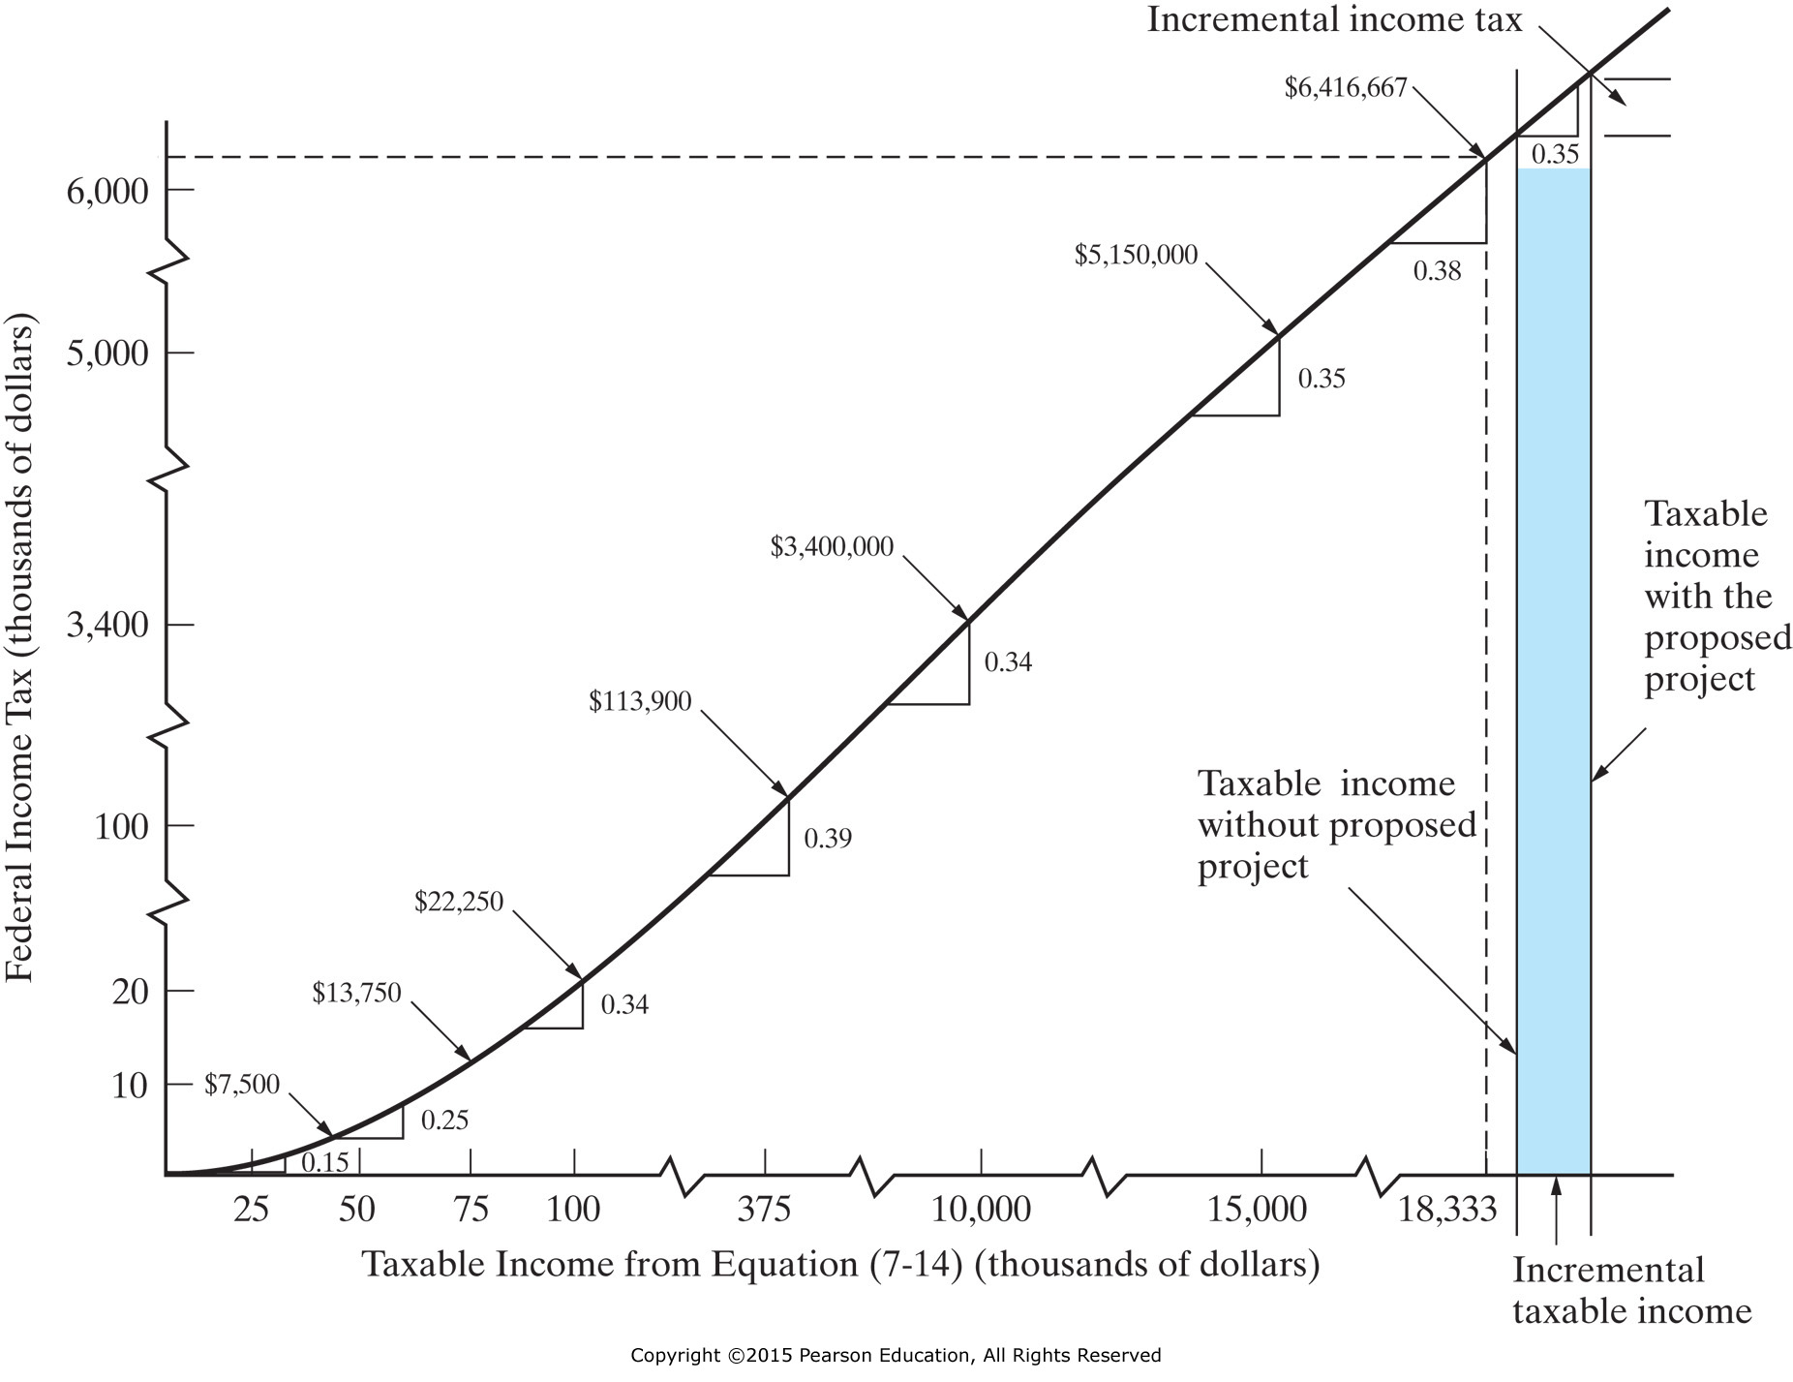
Figure 7-4 The Federal Income Tax Rates for Corporations (Table 7-5) with Incremental Income Tax for a Proposed Project (assumes, in this case, corporate taxable income without project > $18,333,333)

Slide 31
Acme purchased a pump for $250,000 and expended $20,000 for shipping and installation. The addition of this pump will result in an increase in revenue of $80,000, with associated increased expenses of $10,000, each year. The pump has a GDS recovery period of five years, and Acme’s effective tax rate is 41%. What is the ATCF for this project for the fourth year of service of the asset?

Slide 33
Economic value added, EVA, is an estimate of the profit-earning potential of proposed capital investments in engineering projects. It is the difference between a company’s adjusted net operating profit after taxes (NOPAT) in a particular year and its after-tax cost of capital during that year.

Slide 34
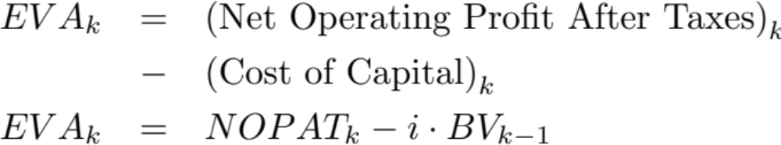
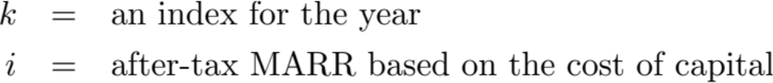
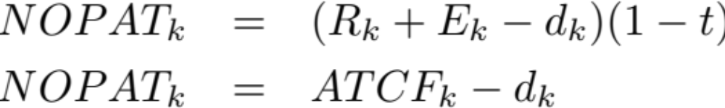
where,
and

Slide 35
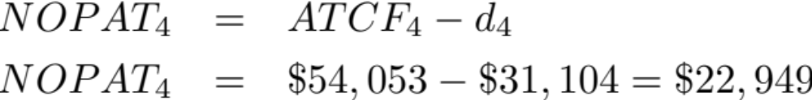
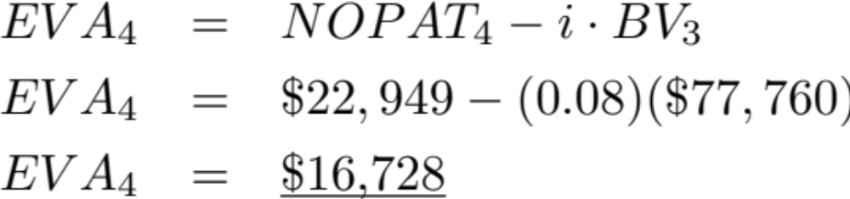
For Acme, what is the EVA for year 4 if their after-tax MARR is 8%?

